Slide 1
WELCOME
Campus…Brings Back So Many Memories That I Would…Have Made…

Slide 2

Campus Recruitment System
Name: Muthulakshmi S
Batch: EB_JAVA 5769
Enrollment No: EBEON0721410013
Guided By
Santosh Mali Sir

Slide 3

Content
Introduction
Home
Admin Login
Student Login
Placement Details
Company To Hire

Slide 4

Introduction
Campus recruitment is a strategy for sourcing, engaging and hiring young talent for internship and entry-level positions.
Candidates through the interview, assessment, offer, hiring and on boarding processes.
It is known and well discussed that young people are more comfortable using and exploiting the available technology compared to the traditional methods.

Slide 5

Technical Specification
HTML
CSS
Java Script
Core Java
IDE
Eclipse

Slide 6
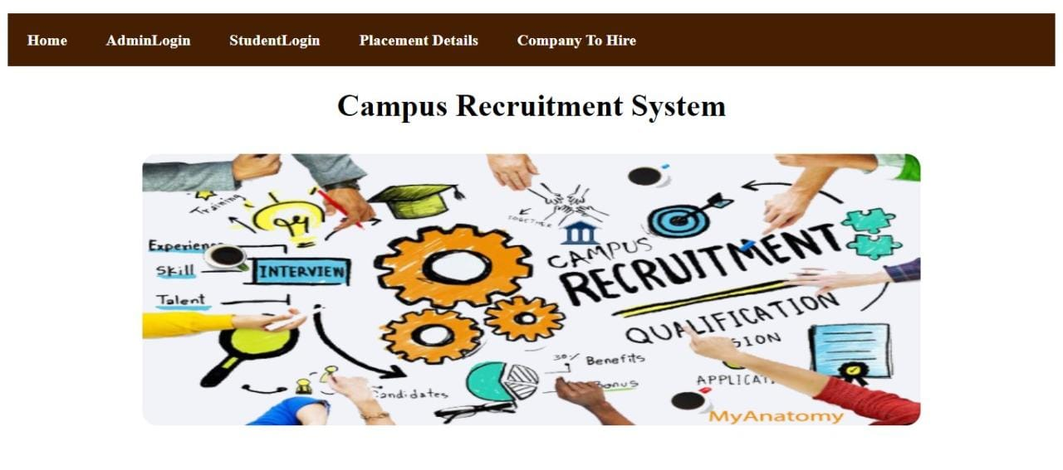
Home Page

Slide 7

Login
A login page is a web page to a website that requires User identification and authentication, regularly performed by entering a username and password combination.
When users come to a web page, and already have an account it should be immediately clear where they go to login. Rather than providing a ‘Login’ link it’s better to show the input fields, so that users can login directly from a page.

Slide 8

Admin Login

Slide 9
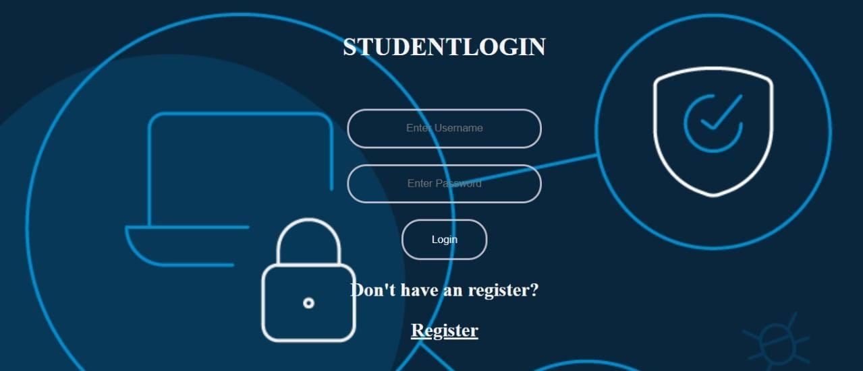
Student Login

Slide 10

Register
Registers are temporary storage areas for instructions or data. Registers work under the direction of the control unit to accept, hold, and transfer instructions or data and perform arithmetic or logical comparisons at high speed.
Efficiency of CPU increases as there are a large number of registers are used in this organization. Less memory space is used to store the program since the instructions are written in a compact way.

Slide 11
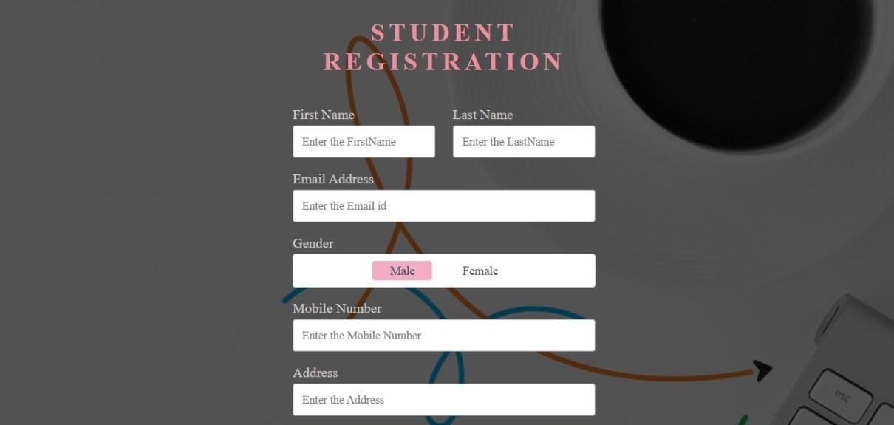
Student Register

Slide 12
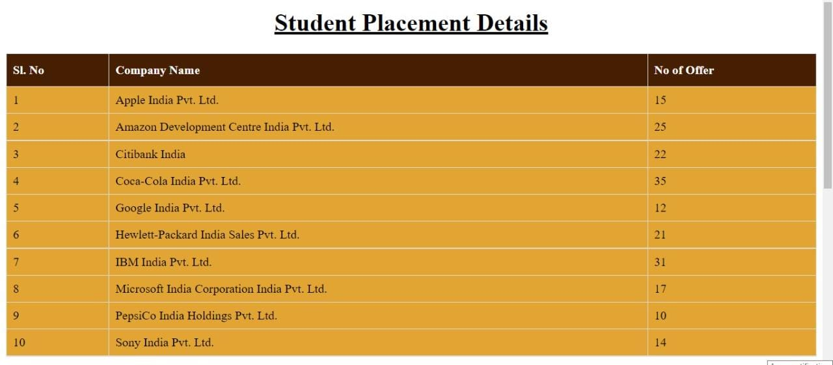
Placement Details

Slide 13

Hire
Hired is a free platform that matches job-seekers with companies in search of talent automatically, and it does so in a wide variety of roles and specialties.

Slide 14

Company To Hire

Slide 15
Conclusion
Effective recruitment and selection can contribute towards an organization's success. During the recruitment process, both internal and external sources of employees should be considered. This will increase the probability of organizations attracting a wide range of candidates.
This recruitment tool is to provide a better experience in recruitment process in terms of saving time and making the right choice. And this tool also comes with the privacy policy in which your data is not visible to others unless you wish to share which makes this tool very secured to use. It is a great tool for campus interviewing and offer management which helps in students career development opportunities.

Slide 16


